Slide 1

[Eagle] Issue Report
Department Strategic Planning
Issued Date
2019.04.15

Slide 2
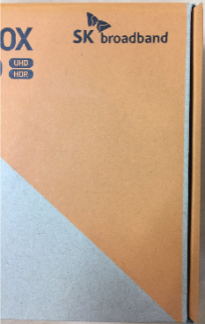
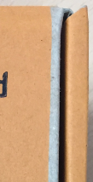


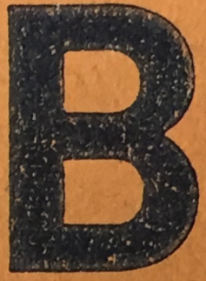
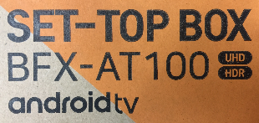
[Eagle] Issue Report
2019.04.15 v0.1
○ Open ◑ Improving ● Closed
Category |  |  | Issue
No. | Item | Version | Image | Contents | Assignment | Status | Reference
01 | Gift Box | 1st sample |  | Issue : Insufficient printing area Improvement : Orange print area expansion required Applying improvement to design artwork v0.4 ([Eagle_BFX-AT100] Gift_Box_Design_v0.4_190412) | ALT | ◑ | 01. Eagle_gift box_upper side.jpg
 |  |  |  |  |  |  | AT100(Android)] Gift_Box_Design_v0.4_190412
02 | Gift Box | 1st sample |  | Issue : Poor print quality Improvement : | FXN | ○ | 02. Eagle_gift box_bottom_icon.jpg
03 | Gift Box | 1st sample |  | Issue : Poor print quality Improvement : | FXN | ○ | 03. Eagle_gift box_upper side_text.jpg

Slide 3

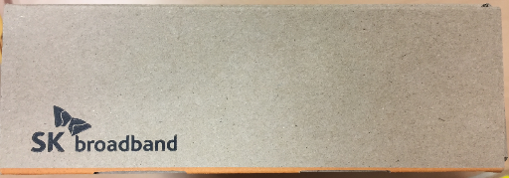
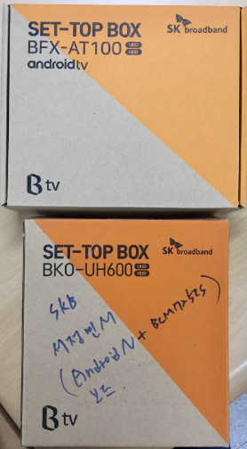
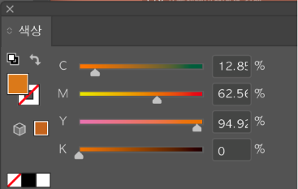
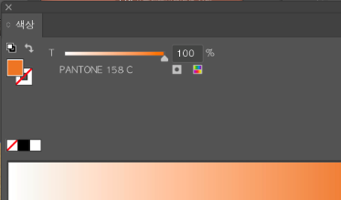
[Eagle] Issue Report
2019.04.15 v0.1
○ Open ◑ Improving ● Closed
Category |  |  | Issue
No. | Item | Version | Image | Contents | Assignment | Status | Reference
04 | Gift Box | 1st sample |  | Issue : Missing printing Improvement : | FXN | ○ | 04. Eagle_gift box_side_label_attachment_guideline.jpg
05 | Gift Box | 1st sample |  | Issue : Color difference compared to comparative model Improvement : Applying improvement to design artwork v0.4 Color change with PANTONE 158C Applying improvement to design artwork v0.4 ([Eagle_BFX-AT100] Gift_Box_Design_v0.4_190412) | ALT | ◑ | 05. Eagle_gift box_color_comparison.jpg
 |  |  |  |  |  |  | [Eagle_BFX-AT100(Android)] Gift_Box_Design_v0.4_190412
Design artwork
1st sample
1st sample
Reference

Slide 4

Thank you.

